Slide 1
Distributed Databases
Advanced DBMS (IGNOU MCS 043 )
Block 2 – Unit 4

Slide 2
Agenda
Introduction
Architecture of DDBMS
Concurrency Control
Commit Protocols – 2PC, 3PC
Replication Server

Slide 3
Introduction
A distributed database is a collection of multiple interconnected databases, which are spread physically across various locations that communicate via a computer network
A distributed database management system (DDBMS) is a centralized software system that manages a distributed database in a manner as if it were all stored in a single location
Heterogenous vs homogenous DB
Functions of DDBMS

Slide 4
Need of a DDBMS
Distributed nature of the organizational units
Need for sharing of data
Support of OLTP and OLAP
Support for multi application platform
Notes:
Distributed Nature of Organizational Units − Most organizations in the current times are subdivided into multiple units that are physically distributed over the globe. Each unit requires its own set of local data. Thus, the overall database of the organization becomes distributed.
Need for Sharing of Data − The multiple organizational units often need to communicate with each other and share their data and resources. This demands common databases or replicated databases that should be used in a synchronized manner.
Support for Both OLTP and OLAP − Online Transaction Processing (OLTP) and Online Analytical Processing (OLAP) work upon diversified systems which may have common data. Distributed database systems aid both these processing by providing synchronized data.
Database Recovery − One of the common techniques used in DDBMS is replication of data across different sites. Replication of data automatically helps in data recovery if database in any site is damaged. Users can access data from other sites while the damaged site is being reconstructed. Thus, database failure may become almost inconspicuous to users.
Support for Multiple Application Software − Most organizations use a variety of application software each with its specific database support. DDBMS provides a uniform functionality for using the same data among different platforms.

Slide 5
Pros and Cons
Advantages
Modular development
More reliable
Better response
Low communication cost
Disadvantages
Need for complex and expensive software
Processing overhead
Data integrity
Improper data distribution
Notes:
Modular Development − If the system needs to be expanded to new locations or new units, in centralized database systems, the action requires substantial efforts and disruption in the existing functioning. However, in distributed databases, the work simply requires adding new computers and local data to the new site and finally connecting them to the distributed system, with no interruption in current functions.
More Reliable − In case of database failures, the total system of centralized databases comes to a halt. However, in distributed systems, when a component fails, the functioning of the system continues may be at a reduced performance. Hence DDBMS is more reliable.
Better Response − If data is distributed in an efficient manner, then user requests can be met from local data itself, thus providing faster response. On the other hand, in centralized systems, all queries have to pass through the central computer for processing, which increases the response time.
Lower Communication Cost − In distributed database systems, if data is located locally where it is mostly used, then the communication costs for data manipulation can be minimized. This is not feasible in centralized systems.

Slide 6
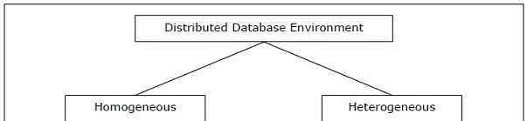
Types of Distributed Databases

Slide 7
Homogenous Distributed DB
The sites use very similar software.
The sites use identical DBMS or DBMS from the same vendor.
Each site is aware of all other sites and cooperates with other sites to process user requests.
The database is accessed through a single interface as if it is a single database

Slide 8
Heterogeneous Distributed DB
Different sites use dissimilar schemas and software.
The system may be composed of a variety of DBMSs like relational, network, hierarchical or object oriented.
Query processing is complex due to dissimilar schemas.
Transaction processing is complex due to dissimilar software.
A site may not be aware of other sites and so there is limited co-operation in processing user requests.

Slide 9
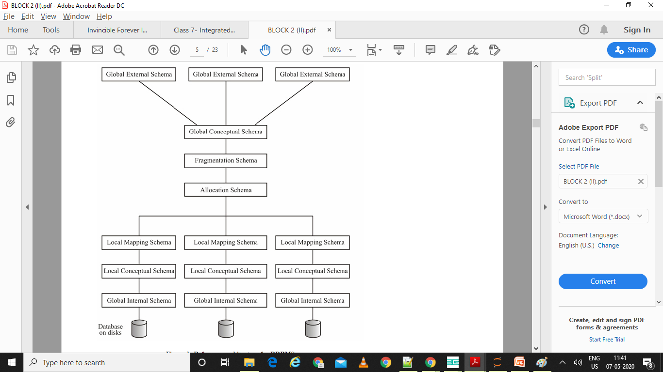
Reference Architecture

Slide 10
Reference Architecture
Global External Schema – defines external application interface
Supports data independence
Logical data independence is provided to db application from the distributed environment
Global Conceptual Schema – defines logical application interface
Defines entities, relationships, constraints
Physical data independence is provided to the application from the distributed environment

Slide 11
Reference Architecture
Fragmentation and Allocation Schema
Describes data fragments that have been created
Describes replicas that have been allocated to various db sites
This identifies data distribution among various sites

Slide 12
Reference Architecture
Local Schema – this includes mapping, conceptual and internal schema
Local Mapping schema – to map the F&A schema of the global system to the local conceptual schema

Slide 13
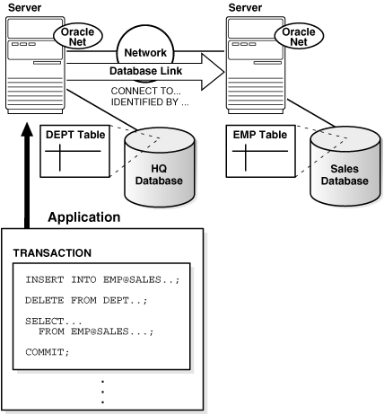
Component Architecture
Notes:
A database link is a connection from the Oracle database to another remote database
Database links are either private or public. If they are private, then only the user who created the link has access; if they are public, then all database users have access.

Slide 14
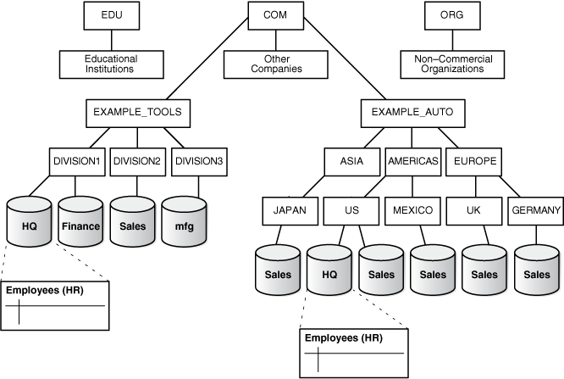
Global DB Names
Notes:
The name of a database is formed by starting at the leaf of the tree and following a path to the root. For example, the mfg database is in division3 of the example_tools branch of the com domain. The global database name for mfg is created by concatenating the nodes in the tree as follows:
mfg.division3.example_tools.com
While several databases can share an individual name, each database must have a unique global database name. For example, the network domains us.americas.example_auto.com and uk.europe.example_auto.com each contain a sales database. The global database naming system distinguishes the sales database in the americas division from the sales database in the europe division as follows:
sales.us.americas.example_auto.com
sales.uk.europe.example_auto.com

Slide 15
Distributed Query Processing
Data Replication: Multiple copies of the data are stored on different sites. This may cause an increase in the overheads of data management, but will improve the availability of the system
Data Fragmentation: It the task of dividing a table into a set of smaller tables. The subsets of the table are called fragments.
Data is stored close to the site of usage, efficiency of the database system is increased

Slide 16
Distributed Query Processing
Q. Find the details of the employee who have sold more than 6000 quantity of item B. The SQL query to evaluate it could be:
SELECT e.empno, e.emp-name, e.phone, e.job
FROM employee@site1 e, sales@site2 s
WHERE e.empno=s.empno AND s.item-code=B AND quantitysold>6000;

Slide 17
Distributed Query Processing
1. Find those tuples at site 2 which satisfy the sales conditions at site 2; now project this table on empno.
SELECT empno
FROM sales@site2
WHERE item-code=B AND quantitysold >6000
This will result in a very small table. Let us store this result in the TEMP table.
2. Now transfer this TEMP table to site 1 and take a join there as:
SELECT *
FROM employee@site1 e, TEMP
WHERE e.empno = TEMP.empno
3. Now send the result of step (ii) back to site 2
Thus, this method reduces the cost of communication and hence may enhance performance.

Slide 18
Distributed Query Processing
A remote query accesses information from one remote site. It may access one or more tables at that site. For example, the following query submitted at site 2:
SELECT * FROM employee@site1;
A distributed query retrieves information from more than one site.
The Remote Procedure Calls (RPCs) is a procedure written in the host language using embedded SQL and are used to perform some tasks at the remote database server site.

Slide 19
Distributed Query Processing
Remote Transaction contains one or more statements that references/modifies data at one remote site.
A distributed transaction includes one or more statements that references/ modifies data on two or more distinct sites of a distributed database.

Slide 20
Concurrency Control
Objectives:
to ensure that various data items and their replications are in a consistent state, when concurrent transactions are going on at the same time, and
to ensure that all the concurrent transactions get completed in finite time
Locking Protocols:
Centralized 2 PL
Primary Copy 2PL
Distributed 2PL

Slide 21
Commit Protocols
Two-phase commit
Three-phase commit

Slide 22
Distributed Locking
Coordinating site: Site at which the transaction is initiated
Participating site: Sites at which the sub-transactions get executed
S2
T1
T12
S1
S3
T13

Slide 23
Distributed Locking
Transaction Manager: Each site has a TM that manages the execution of transactions that access data stored in that site
Transaction Coordinator: Each site has a TC that coordinates all the transactions initiated at that site
Notes:
TC at S1 will be responsible for transaction T1 and its sub-transactions T12 and T13

Slide 24
Single Lock Manager
System maintains a single lock manager that resides in one of the chosen sites
All lock/unlock requests are sent to this site
S2
For read lock request, data at a site is
locked in shared mode
Lock(X)
Grant/Deny
For write lock request, all replicas of
data are locked in exclusive mode and
then updated
S1
Grant/Deny
S3
Lock
Manager
Lock(Y)

Slide 25
Single Lock Manager
Advantages:
Easy to implement
Can detect deadlocks easily
Disadvantages:
Sending all requests to a single site may lead to a bottleneck situation
System becomes less reliable, as there is only one site for lock management

Slide 26
Distributed Lock Manager
Each site maintains a local lock manager that handles lock & unlock requests from that site
Lock
Manager
S2
Lock(X)
Lock(Z)
Grant/Deny
Grant/
Deny
S1
Grant/Deny
S3
Lock
Manager
Lock
Manager
Lock(Y)

Slide 27
Distributed Lock Manager
Advantages:
Read-One-Write-All type of protocol
For reading, any replica of the data can be read
For updating, all replicas must be exclusively locked
Locks are managed in a decentralized manner
Disadvantages:
Deadlock handling is complex
High cost involved in performing updates

Slide 28
Timestamp Protocol
To order the transactions as per the timestamp
Older transaction has lower timestamp and should be given the resources first
In a distributed system, local and global timestamps are assigned to each transaction

Slide 29
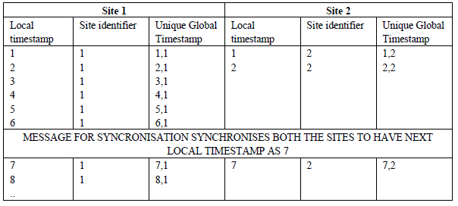
Timestamp Protocol

Slide 30
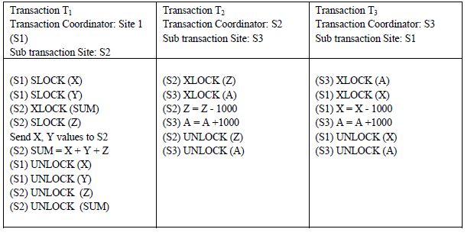
Deadlock management

Slide 31
Deadlock management

Slide 32
Deadlock Management
Global wait-for graph detects a cycle => DEADLOCK
T1
T2
T3

Slide 33
Two-phase Commit Protocol
Commit protocol for distributed transactions
Phases:
Voting Phase – P sites vote for commit/abort
Decision Phase – C site decides whether to commit/abort
Example: transaction T1 starts at site S1. It has sub-transactions at sites S2, S3 and S4
Coordinator site: S1
Participating sites: S2, S3, S4
Notes:
https://www.youtube.com/watch?v=ZcHXyoEay1o

Slide 34
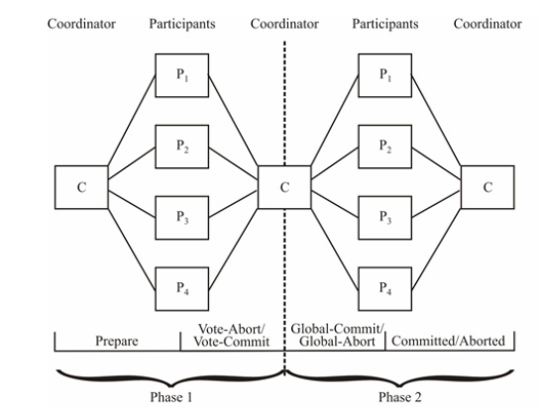
Two-phase Commit Protocol

Slide 35
Three-phase Commit Protocol
An extension of 2PC that avoids blocking even if the coordinating site fails
Conditions to avoid blocking:
No network partitioning
At least one site is available
At most k sites can fail
Three phases
Voting
Pre-commit
Commit
Notes:
https://www.youtube.com/watch?v=fmJvYjSQuUY

Slide 36
Replication Server
Move transaction to many destinations
Move data or only a subset of data from one source to another
Transform data when moving from one source to destination such as merging data from several source databases into one destination database
Moving data through a complicated network

Slide 37
Replication Server
Advantages:
It is efficient, because it only replicates original data that is added, modified, or deleted.
Enhances performance. This is because of the fact that, the Replication Server copies the data to the remote server that a remote user can access over the Local Area Network (LAN).
Excellent feature for disaster recovery. If the local data server or local network is down and transactions need to be replicated, then the Replication Server will perform all of the necessary synchronisation on the availability of the local data server or the local network.

Slide 38
Thank You

